Slide 1
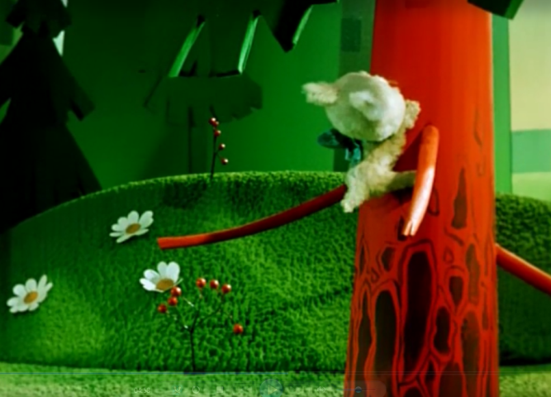
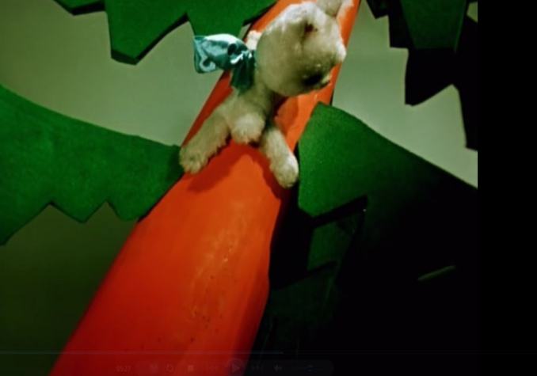
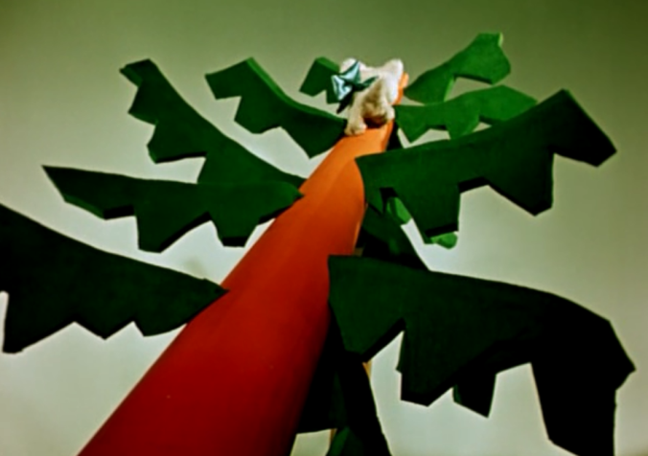
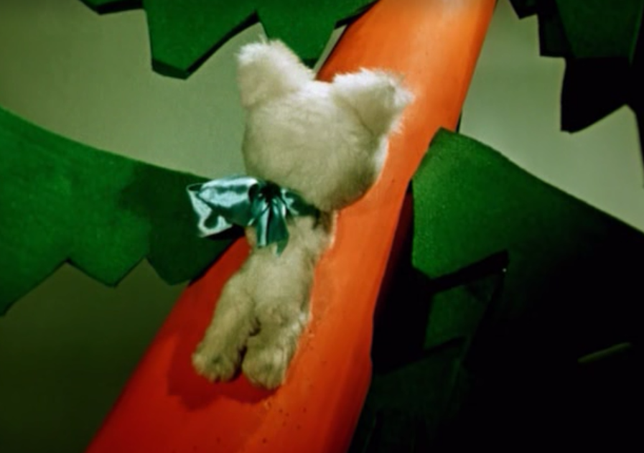
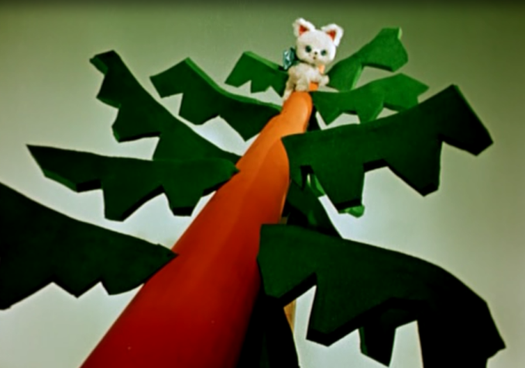
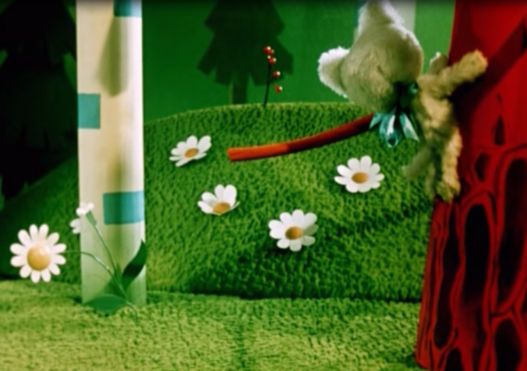
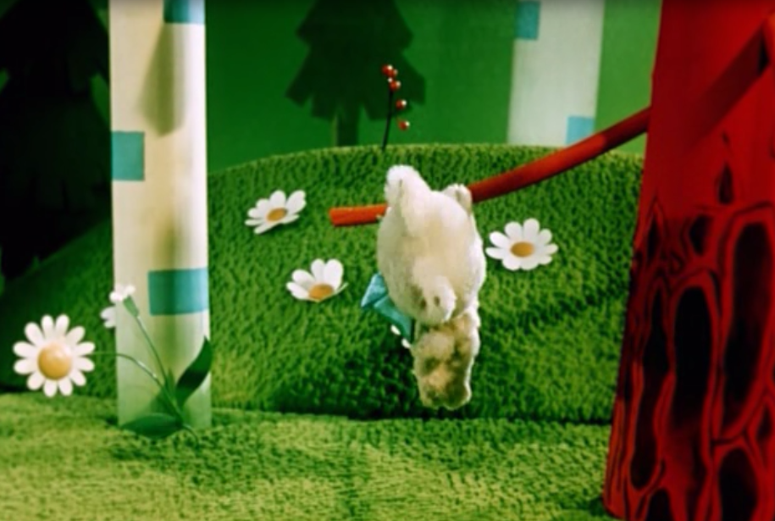
Acquisition of motion in Russian
Polina Eismont
^{polina272@hotmail.com}
Saint-Petersburg State University of Aerospace Instrumentation
Introduction
In XX century the development of cognitive linguistics caused the growth of verb semantic researches in different languages. An outstanding research by Leonard Talmy [Talmy 2000 and others] determined the subsequent direction of these studies. All languages distinguish in structuring motion events paying special attention either to the manner of motion (satellite-framed languages), or to the path of motion (verb-framed languages). Being a satellite-framed language Russian represents the path information in prefixes and prepositions [Slobin 2004; Maisak 2005]. The acquisition of motion semantics differs in languages as well [Slobin 2004], and Russian that reflects both manner and path semantics within a word stem may provide some valuable information to identify the process of motion understanding.
Verbs of motion
All characters in every experiment produced lots of different actions of moving, speaking, manipulating with objects, etc. The total number of 6521 verb tokens (1254 lexemes) have been analyzed, 398 of them were the verbs of motion.
There is no statistically significant difference in the use of manner or path specified verbs of motion between different age groups. The most frequent verb families for the youngest group are prygat’ (jump) with 5 derivates and idti/hodit’ (go) with 3 derivates. For all other groups the most frequent verb families are lezt’ (climb), idti/hodit’ (go), prygat’ (jump) and bezhat’ (run). Surprisingly, the verb idti/hodit’ is less frequent than the verb bezhat’ while the actions of the characters (small kittens) are likely to be understood as a rapid motion (compare the definition of idti as “moving by walking’ and the definition of bezhat’ as “moving quickly, faster than walking’). It may be explained with the fact that the verbs idti/hodit’ are prototypical for Russian verbs of motion, and children prefer them to all the others because of their general meaning. The same reason of general meaning may help to understand the use of poshel na derevo (went to the tree) or pobezhal na derevo (ran to the tree) to describe the motion of climbing.
The case of lezt’ (climb)
rank | 3 |  |  | 4 |  |  | 5
1 | zalezt' | climb up | 24 | zalezt' | climb up | 26 | zalezt' | climb up | 25
2 | slezat' | climb down | 19 | spuskat'sya | get down | 13 | spustit'sya | get down | 17
3 | zabrat'sya | scramble up | 15 | slezt' | climb down | 12 | spuskat'sya | get down | 15
3 | spustit'sya | get down | 15
4 | slezt' | climb down | 14 | slezat' | climb down | 11 | slezt' | climb down | 14
5 | upast' | fall down | 11 | polezt' | start climbing | 10 | pobezhat' |  | 10
6 | zalezat' | climb up | 10 | zabrat'sya | scramble up | 9 | slezat' | climb down | 9
6 | lezt' | climb | 10 | upast' | fall down | 9
7 | spuskat'sya | get down | 9 | lezt' | climb | 7 | polezt' | start climbing | 8
7 |  |  |  | spustit'sya | get down | 7
8 | pojti | go to | 7 | zabirat'sya | scramble up | 6 | zalezat' | climb up | 7
8 | polezt' | start climbing | 7 | zalezat' | climb up | 6
8 |  |  |  | padat' | fall down | 6
9 | lazit' | climb | 3 | sprygnut' | jump down | 5 | upast' | fall down | 5
9 | pobezhat' | start running | 3 |  |  |  | ubezhat' | run off | 5
9 | pokatit'sya | start rolling | 3 |  |  |  | lezt' | climb | 5
9 | svalit'sya | flop down | 3 |  |  |  | zabrat'sya | scramble up | 5
9 | slazyvat' | climb down | 3
10 | lazat' | climb | 2 | spolzat' | crawl down | 4 | sprygnut' | jump down | 4
10 | poekhat' | start going | 2 |  |  |  | zabirat'sya | scramble up | 4
10 | skol'zit' | slide | 2
10 | sprygnut' | jump down | 2
Children of the oldest groups used fewer verbs to describe the upward movement (lezt’, zalezt’, zabrat’sia and karabkat’sia) than to describe the downward movement (slezt’, spuskat’sia, spolzat’, skol’zit’, svalit’sia, upast’, etc.). At the same time children of the younger age use more verbs to describe this motion but prefer general unspecified words, cf. pobezhal na derevo (ran to the tree), where path is experessed with the preposition (na – onto), and there is no mention of climbing manner.
Children of all groups used the verbs zabrat’sia/zabirat’sia for upward movement and the verbs spuskat’sia/spustit’sia for downward movement, but all these verbs neither specify the manner of movement, nor have any movement semantics in their roots. Although these path specifying verbs are quite highly ranked in all three groups, the verbs zabrat’sia/zabirat’sia are more typical for younger children, while the verbs spuskat’sia/spustit’sia are more frequent for the oldest children.
Material
The corpus “Konduit” [Eismont 2017] consists of 215 unprepared elicited oral child narratives, that have been collected during a series of experiments with Russian native children at the age of 2;7-7;6. The total number of tokens is 25689.
Three different methods have been chosen for the experiments. The youngest children participated in a specially designed game, when two experimenters produced different actions with bibabo toys, and children had to name these actions to defeat the wizard. The children at the age of 3;7-4;6 had to retell a picture book named “Three kittens” which tells a funny story of three kittens, who get into troubles trying to catch a mouse, a frog and a fish, but fail. The oldest children at the age of 4;7-7;6 (groups 3, 4 and 5) had to retell a cartoon about a kitten who tried to be friends with rabbits, beavers and a bear-cub, but also failed. Each narrative has been audio and video recorded, each subject was recorded individually.
Age group | Mean Age | М | F | Total number of subjects | Number of words (Me) | Number of utterances (Me) | MLU (Me)
1 | 3;1 | 21 | 16 | 37 | 20 | 13 | 1,5
2 | 4;2 | 30 | 20 | 50 | 84.5 | 27 | 3,12
3 | 5;0 | 25 | 24 | 49 | 108 | 23 | 4,61
4 | 6;0 | 20 | 22 | 44 | 174,5 | 34 | 5,10
5 | 6;9 | 16 | 19 | 35 | 190 | 34 | 5,39
Top-5 motion verbs:
Percentage of prefixed lexemes
The kitten is climbing up and down the tree
Conclusions
The analysis has shown that there is no statistically significant difference between different age groups from 3;7-4;6 (unfortunately, we have too small sampling of verbs for the children at the age of 2;7-3;6 to make any statistical analysis).Even at the age of 3;7 children differentiate manner of motion in their speech. But the age influences the representation of path. The younger children at the age 3;7-5;6 tend to use verbs with the prefix po-, that means the start of an action (cf. polezt’ – to start climbing; pobezhat’ – to start running, etc.), then they develop their understanding of path and use both manner verbs (skolzit’ – to slide; karabkat’sia – to clamber; polzti – crawl, etc.) and path verbs (zabrat’sia; spuskat’sia). The process of the acquisition of Russian verbs of motion is following. At the early age children acquire the prototypical verbs with no specific manner or path semantics and few manner verbs that denote typical child actions
(jump, clomp, etc.). Then they acquire the basic morphological set of derivational affixes and start
using some prefixed verbs with specified manner and path information. Later after achieving some
critical mass of such verbs they try to arrange them and tend to use general verbs to avoid any
possible uncertainty. And only after their lexicon gets some appropriate arrangement they achieve the
adult-like mode, when both manner and path are expressed within a verb form. The study of verbs of
different semantics and of their use in child narratives has proved that it usually happens at the age
between 5 and 6.
Frequency of top-10 motion verbs and their prefixed derivates
 | 1 |  | 2 |  | 3 |  | 4 |  | 5
 | lexemes | frequency | lexemes | frequency | lexemes | frequency | lexemes | frequency | lexemes | frequency
bezhat' (run) | 2 | 2 | 7 | 65 | 8 | 24 | 7 | 29 | 10 | 50
pr+bezhat' (run) | 1 | 1 | 5 | 46 | 6 | 20 | 6 | 28 | 9 | 49
idti (go) | 3 | 3 | 6 | 21 | 6 | 129 | 8 | 166 | 9 | 152
pr+idti (go) | 2 | 2 | 5 | 14 | 5 | 109 | 7 | 151 | 8 | 135
lezt' (climb) | 1 | 2 | 12 | 151 | 14 | 104 | 13 | 105 | 12 | 111
pr+lezt' (climb) | 1 | 2 | 9 | 138 | 11 | 88 | 11 | 97 | 10 | 104
ehat' (go by any vehicle) | 1 | 1 | 0 | 0 | 9 | 29 | 8 | 49 | 9 | 41
pr+ehat' (go by any vehicle) | 1 | 1 |  |  | 8 | 20 | 7 | 43 | 7 | 33
karabkat'sia (scramble) | 0 | 0 | 0 | 0 | 1 | 1 | 2 | 3 | 1 | 2
pr+karabkat'sia (scramble) |  |  |  |  | 0 | 0 | 1 | 1 | 0 | 0
polzti (crawl) | 0 | 0 | 1 | 1 | 1 | 1 | 4 | 9 | 3 | 5
pr+polzti (crawl) |  |  | 0 | 0 | 1 | 1 | 3 | 7 | 1 | 1
skakat' (leap) | 1 | 1 | 2 | 5 | 2 | 6 | 5 | 7 | 2 | 2
pr+skakat' (leap) | 0 | 0 | 2 | 5 | 1 | 1 | 4 | 5 | 2 | 2
hodit' (walk) | 2 | 4 | 2 | 4 | 4 | 13 | 5 | 5 | 5 | 11
pr+hodit' (walk) | 1 | 1 | 1 | 3 | 3 | 7 | 5 | 5 | 4 | 7
prygat' (jump) | 3 | 32 | 5 | 24 | 7 | 77 | 9 | 94 | 7 | 79
pr+prygat' (jump) | 1 | 5 | 3 | 4 | 5 | 11 | 7 | 32 | 5 | 22
katat'sia (roll) | 1 | 1 | 0 | 0 | 5 | 27 | 6 | 15 | 6 | 19
pr+katat'sia (roll) | 0 | 0 |  |  | 3 | 6 | 5 | 7 | 4 | 7
general root verbs
manner +/-
path -
general prefixed verbs
manner +/-
path +/-
prefixed verbs
manner +
path +
Pre-program Medication Errors (Jan-Sep 2006; n=191)
References
Eismont P.M. “Konduit”: korpus ustnyh detskih tekstov (“Konduit”: corpus of child oral narratives). (In Russian). Saint-Petersburg: Saint Petersburg State University, 2017. Pp.373-377.
Maisak T. А. Tipologya grammatikalizacii konstrukciy s glagolami dvizheniya i glagolami pozicii (Typology of the verbs of motion and the verbs of position grammaticalisation). (In Russian) Moscow, 2005.
Slobin, Dan I. The many ways to search for a frog: Linguistic typology and the expression of motion events. In: S. Strömqvist & L. Verhoeven (Eds.) (2004), Relating events in narrative: Vol. 2. Typological and contextual perspectives (pp. 219-257). Mahwah, NJ: Lawrence Erlbaum Associates.
Talmy, Leonard. Toward a Cognitive Semantics. Vol. 2: Typology and process in concept structuring. Camdridge: MIT Press, 2000.
This research has been supported by Russian Fund for the Humanities, grant No 16-04-50114

